Slide 1





V.T. Patel Department of Electronics & Communication Engineering
Charotar University of Science & Technology (CHARUSAT)
Chandubhai S Patel Institute of Technology
Project presentation on “HOME AUTOMATION AND DOOR LOCK SYSTEM USING MICRCONTROLLER & rfid MODULE”
Prepared By : KACHHIYA KRUP
(19EC019)
EC Department,
CSPIT, CHARUSAT
Pedagogue : VISHAL TANK
Assistant Professor
EC Department,
CSPIT, CHARUSAT

Slide 2
P r e s e n t a t I o n
F
L
O
W
Introduction
Aim, Objective
Components
Circuit Diagram
Code
Working Process
Final PCB design
Applications
PCB view
Limitations
Conclusion
References
O
F

Slide 3

Introduction
Nowadays, we have remote controls for television sets and other electronics system, which have made our live easy. Have you ever wondered about home automation and home security which would give the facility of controlling tube lights, fans and other electrical appliances at home using a remote control?
Off-course, Yes! But, are the available options cost-effective? If the answer is No, I have found a solution to it. I have come up with a new system called Microcontroller based home automation using Bluetooth and home security using RFID & Servo motor .
This system is super-cost effective and can give the user, the ability to control any electronic device without even spending for a remote control & protect the home.

Slide 4

This project helps the user to control all the electronic devices using his/her smartphone.
Instead of smart phone he/she can make an digital remote control using HC-05 and microcontroller. In which the remote control HC-05 to be a master and the Bluetooth of the circuit should be a slave.
Time is a very valuable thing. Everybody wants to save time as much as they can. New technologies are being introduced to save our time. To save people’s time we are introducing Home Automation system using Bluetooth and Home Security system using RFID With Tags .
With the help of this system you can control your home appliances from your mobile phone and protect your house . You can turn on/off your home appliances within the range of Bluetooth and open door without any key using wireless contact.

Slide 5

Objective Of Project
The objective of this project is to implement a low cost , reliable and scalable home automation system that can be used to remotely switch on or off any household appliance , using a microcontroller to achieve hardware simplicity ,low cost short messaging service for feedback and voice dial from any phone to toggle the switch state.
Project Aim
The aim of the project is to design and construct a home automation system that will remotely switch on or off any household appliances connected to it, using a Microcontroller , voice dial on phone , or Bluetooth based android application.
Also to design and construct home security system that will remotely lock or unlock using a Microcontroller or RFID based of frequency identification or Servo motor based on coding.

Slide 6
Required Components
Sr. No. | Components | Price
1 | Atmega328P-PU | 110 /-
2 | Bluetooth HC-05 | 220 /-
3 | RFID with Tags | 175 /-
4 | Resistor [ 220Ω ] | .50 /-
5 | Capacitor [ 22pf ] | .50 /-
6 | Led | 2 /-
7 | Voltage regulator 7805 | 5 /-

Slide 7

8 | Voltage regulator AMS1117 – 3.3V | 10 /-
9 | CAPACITOR [ 1μf ] | .25 /-
10 | Relay | 5 /-
11 | Servo motor | 90 /-
12 | Crystal | 2 /-
13 | NPN Transistor [ BC547 ] | 1 /-
16 | SPDT Push Button | 10 /-
17 | Female & Male Header | 10 /-
18 | Female & Male Jumper / Connecting wire | 0.5 /-
19 | 9V Battery / Adapter | 15 /-

Slide 8
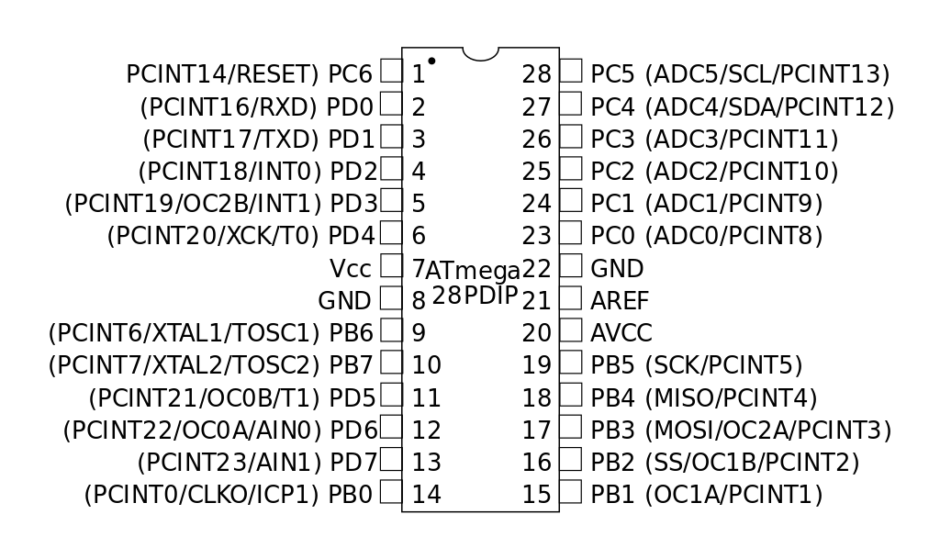
Atmega328P-PU
The ATmega328 is a single-chip microcontroller created by Atmel in the megaAVR family (later Microchip Technology acquired Atmel in 2016). It has a modified Harvard architecture 8-bit RISC processor core.
The Atmel 8-bit AVR RISC-based microcontroller combines 32 KB ISP flash memory with read-while-write capabilities, 1 KB EEPROM, 2 KB SRAM, 23 general purpose I/O lines, 32 general purpose working registers, three flexible timer/counters with compare modes, internal and external interrupts, serial programmable USART, a byte-oriented 2-wire serial interface, SPI serial port, 6-channel 10-bit A/D converter ( 8-channels
in TQFP and QFN/MLF packages ), programmable watchdog timer with internal oscillator, and five software selectable power saving modes. The device operates between 1.8-5.5 volts. The device achieves throughput approaching 1 MIPS per MHz.

Slide 9

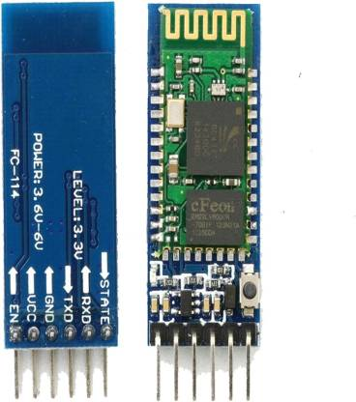
Bluetooth HC-05
HC-05 module is an easy to use Bluetooth SPP (Serial Port Protocol) module, designed for transparent wireless serial connection setup.
Serial port Bluetooth module is fully qualified Bluetooth V2.0+EDR (Enhanced Data Rate) 3Mbps Modulation with complete 2.4GHz radio transceiver and baseband.
It uses CSR Bluecore 04-External single chip Bluetooth system with CMOS
technology and with AFH(Adaptive Frequency Hopping Feature).
It has the footprint as small as 12.7mmx27mm. Hope it will simplify your overall design/development cycle.

Slide 10
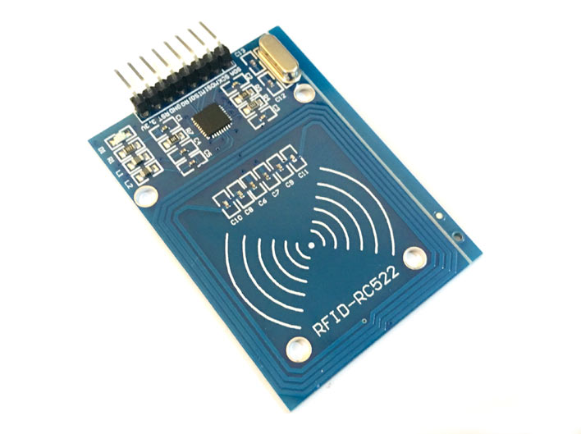

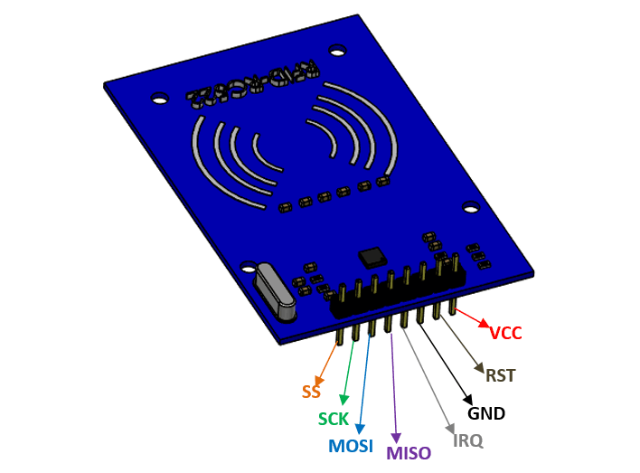
RFID with Tags
The RC522 is a 13.56MHz RFID module that is based on the MFRC522 controller from NXP semiconductors. The module can supports I2C, SPI and UART and normally is shipped with a RFID card and key fob. It is commonly used in attendance systems and other person/object identification applications.
The RC522 is a RF Module that consists of a RFID reader, RFID
card and a key chain. The module operates 13.56MHz which is industrial (ISM) band and hence can be used without any license problem. The module operates at 3.3V typically and hence commonly used in 3.3V designs. It is normally used in application where certain person/object has to be identified with a unique ID.
The keychain has 1kB memory in it which can be used to stored unique data. The RC522 reader module can both read and write data into these memory elements. The reader can read data only form passive tags that operate on 13.56MHz.

Slide 11
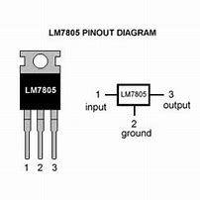

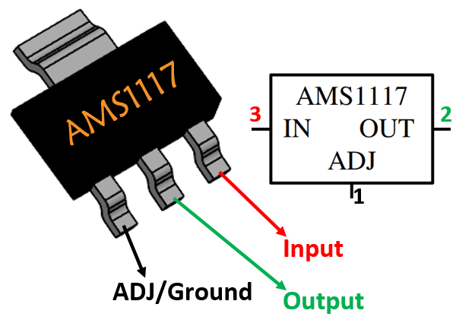
Voltage regulator 7805
7805 is a three terminal linear voltage regulator IC with a fixed output voltage of 5V which is useful in a wide range of applications. Currently, the 7805 Voltage Regulator IC is manufactured by Texas Instruments, ON Semiconductor, STMicroelectronics, Diodes incorporated, Infineon Technologies, etc.
Some of the important features of the 7805 IC are as follows:
It can deliver up to 1.5 A of current (with heat sink).
Has both internal current limiting and thermal shutdown features.
Requires very minimum external components to fully function.
Voltage regulator AMS1117 – 3.3V
The AMS1117 is a popular SMD package 3-pin voltage regulator that is available in many models for fixed and adjustable voltage requirements. The IC can deliver a maximum current of 1A and the output voltage can vary from 1.5V to 5V. It also has a low drop out voltage of 1.3V when operating at maximum current.
Some of the important features of the AMS1117 IC are as follows:
3.3V Output
5V Input. Can use higher input voltages, but see our notes below about derating the current at higher voltages
Short circuit and thermal protection built-in
Small footprint

Slide 12

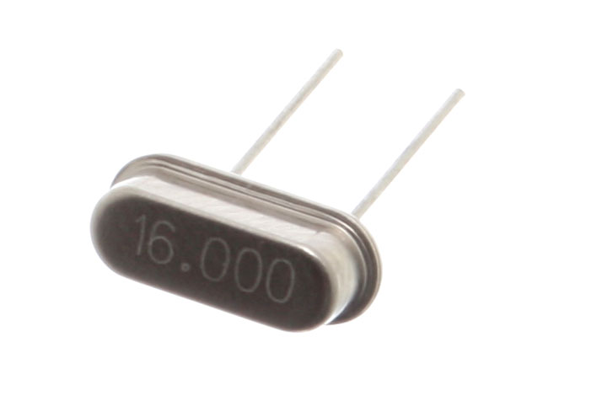
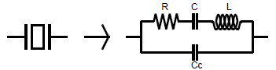
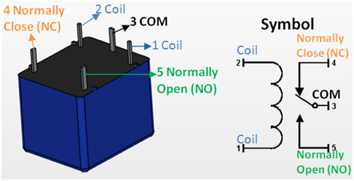
Crystal
The 16 MHz Crystal Oscillator module is designed to handle off-chip crystals that have a frequency of 4 -16 MHz. The crystal oscillator.s output is fed to the System PLL as the input reference. The oscillator design generates low frequency and phase jitter, which is recommended for USB operation.
The crystal model is based on the following components:
L: Motional Inductor
C: Motional Capacitor
R: Equivalent Series Resistor
Cc: Shunt Capacitor
Relay
A relay is an electrically operated switch. It consists of a set of input terminals for a single or multiple control signals, and a set of operating contact terminals. The switch may have any number of contacts in multiple contact forms, such as make contacts, break contacts, or combinations thereof.
The traditional form of a relay uses an electromagnet to close or open the contacts, but other operating principles have been invented, such as in solid-state relays which use semiconductor properties for control without relying on moving parts. Relays with calibrated operating characteristics and sometimes multiple operating coils are used to protect electrical circuits from overload or faults; in modern electric power systems these functions are performed by digital instruments still called protective relays.

Slide 13
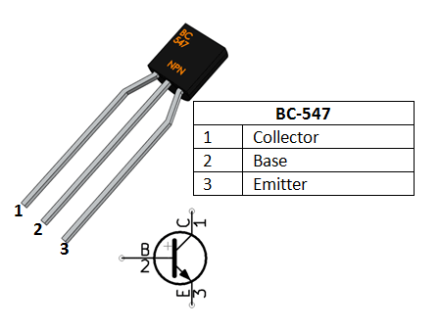

Servo motor
Servo control is achieved by sending a servo a PWM (pulse-width modulation) signal, a series of repeating pulses of variable width where either the width of the pulse (most common modern hobby servos) or the duty cycle of a pulse train (less common today) determines the position to be achieved by the servo. The PWM signal might come from a radio control receiver to the servo or from common microcontrollers such as the Arduino.
Small hobby servos (often called radio control, or RC servos) are connected through a standard three-wire connection: two wires for a DC power supply and one for control, carrying the control pulses.
NPN Transistor [ BC547 ]
The BC547 is a general-purpose NPN bipolar junction transistor commonly used in European and American electronic equipment. It is notably often the first type of bipolar transistor hobbyists encounter and is often featured in designs in hobby electronics magazines where a general-purpose transistor is required. The BC547 is low in cost and widely available.
The BC547 is a part of a family of NPN and PNP epitaxial silicon transistors that originated with the metal-cased BC108 family of transistors.

Slide 14
Circuit Diagram
The circuit Diagram consists of following unit:
Processing unit
Entry unit
Bluetooth Input unit
Output unit
Locking and unlocking unit
The processing unit consist of microcontroller which is receives command from the Bluetooth and RFID and converts the input signals to output signals to the Servo Motor and lamp which can perform task
The entry unit consists of RFID which scan the Tags if the tags passcode not matched with the passcode which is input in program then it will not convey the signal to the processing unit, either if the tag passcode match with the passcode which is written in the code of system then signal transfer to Processing unit and the microcontroller pass the task to servo motor which open or close the door.
Note : We can use adapter instead of battery in whole circuit where needed.

Slide 15

The Bluetooth Input unit consists of the HC-05 Bluetooth Module which wirelessly take the command from the mobile and pass the signals to the processing unit in which the microcontroller pass the command to output unit in which the relay get active and the lamp or led get blow.
The Output unit consists of relay transistor and bulb which takes the input from the processing unit and perform task. As the processing unit passes the task in accordance with the processing unit take the input from the Bluetooth which get the input from the users mobile .
The Locking and unlocking unit consists of servo motor which works on PWM signal. When the tags is scan to RFID module the module passes the signals to the processing unit and the microcontroller check the passcode which is pass by the RFID with the passcode of the inbuilt program. If the passcode are matched with each other then microcontroller the give order to the servo motor rotate at a particular angle. And as the door get locked or unlocked.
The circuit diagrams as follow :
Schematic diagram of whole circuit 4. Bluetooth Input unit
Processing unit 5. Output unit
Entry unit 6. Locking & Unlocking Unit

Slide 16
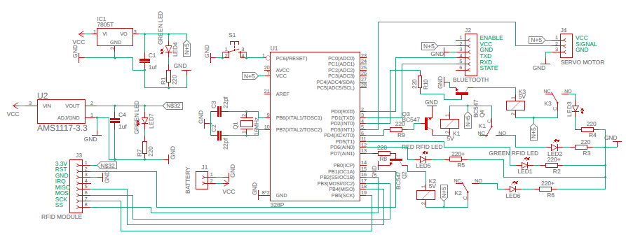

Slide 17

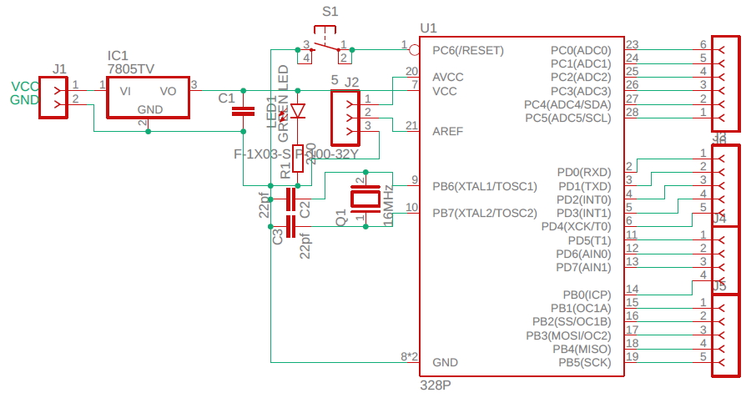
T
H
E
P
R
O
C
E
S
S
I
N
G
U
N
I
T

Slide 18
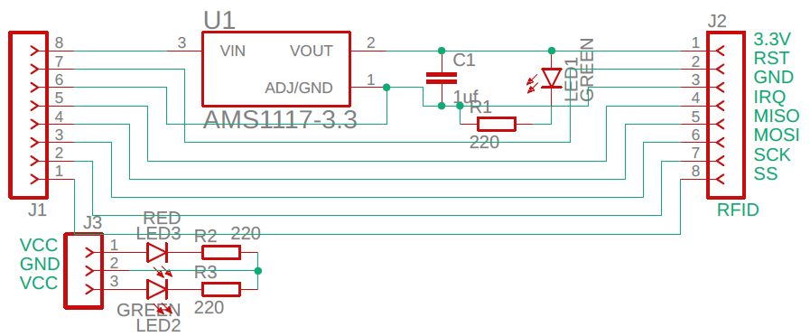
T
H
E
E
N
T
R
Y
U
N
I
T

Slide 19
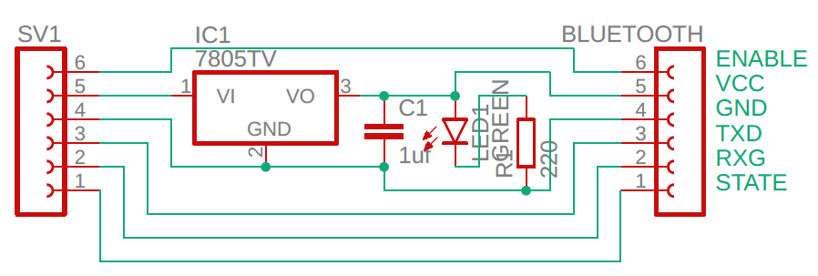
T
H
E
B
L
U
E
T
O
O
T
H
I
N
P
U
T
U
N
I
T

Slide 20
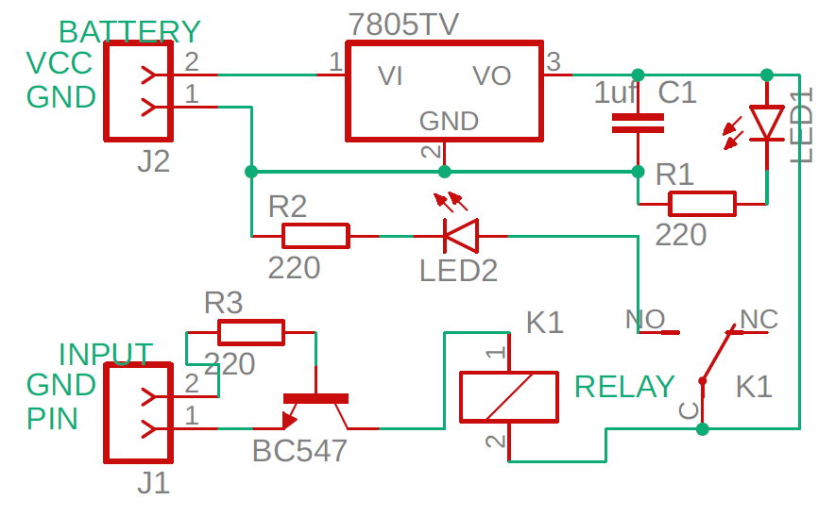
THE OUTPUT UNIT

Slide 21
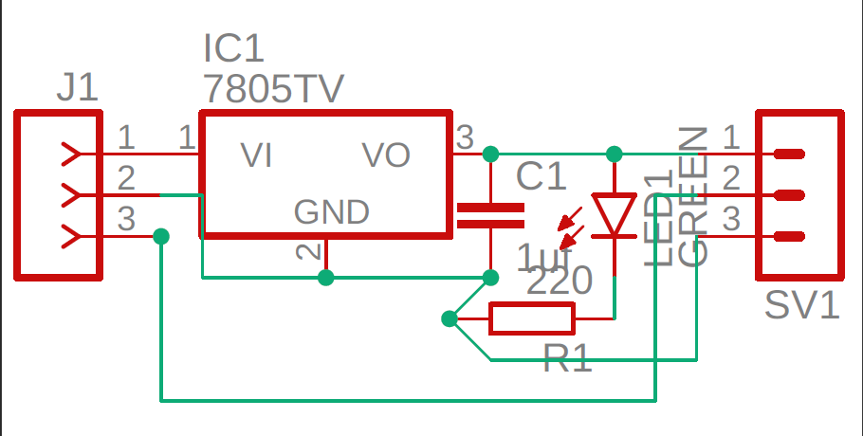
THE LOCKING & UNLOCKING UNIT

Slide 22
Source Code
//INCLUDING THE FILES FOR
// THE SERVO MOTOR & RFID
#include<SPI.h>
#include<MFRC522.h>
#include<Servo.h>
// LAMP DECLARATION
#define Lamp1 2
#define Lamp2 4
#define Lamp3 7
//LED FOR RFID
#define Led1 5
#define Led2 6
// RFID PIN DECLARATION
#define SS_PIN 10
#define RST_PIN 9
// SERVO MOTOR DECLARATION
#define SERVO_PIN 3
Servo myservo;
//PIORITY DECLARATION
#define ON HIGH
#define OFF LOW
// ACCESS & DELAY
#define ACCESS_DELAY 2500
#define DENIED_DELAY 2500
//CREATE MFRC522
MFRC522 mfrc522(SS_PIN,RST_PIN);
char val;
String statusLamp1;
String statusLamp2;
String statusLamp3;
void setup()
{
// INITIALIZATION OF INPUT/OUTPUT OF LAMP
pinMode(Lamp1,OUTPUT);
digitalWrite(Lamp1,ON);
delay(75000);
pinMode(Lamp2,OUTPUT);
digitalWrite(Lamp2,ON);
pinMode(Lamp3,OUTPUT);
digitalWrite(Lamp3,ON);
// INITIALIZATION OF LED
pinMode(Led1,OUTPUT);
digitalWrite(Led1,OFF);
pinMode(Led2,OUTPUT);
digitalWrite(Led2,OFF);
//INITIATE A SERIAL COMMUNICATION

Slide 23

Serial.begin(9600);
//INITIATE SPI BUS
SPI.begin();
//INITIATE MFRC522
mfrc522.PCD_Init();
myservo.attach(SERVO_PIN);
myservo.write(70);
myservo.write(0);
Serial.println("Put your card to the reader ....");
Serial.println();
}
void loop()
{
//LOOK FOR THE NEW CARD
if(!mfrc522.PICC_IsNewCardPresent())
{
return;
}
//SELECT ONE OF THE CARD
if(!mfrc522.PICC_ReadCardSerial())
{
return;
}
//SHOW UID ON SERIAL MONITOR
Serial.print("UID tag :- ");
String content="";
byte letter;
for(byte i=0;i<mfrc522.uid.size;i++)
{
Serial.print(mfrc522.uid.uidByte[i]<0x10?"0":" ");
Serial.print(mfrc522.uid.uidByte[i],HEX);
content.concat(String(mfrc522.uid.uidByte[i]<0x10?"0":" "));
content.concat(String(mfrc522.uid.uidByte[i],HEX));
}
Serial.println();
Serial.print("Message :- ");
content.toUpperCase();
//CHANGE HERE THE UID
if(content.substring(1)=="B7 D5 79 60")
{
Serial.println("Authorized access");
Serial.println();
myservo.write(70);
delay(ACCESS_DELAY);
digitalWrite(Led1,ON);
delay(ACCESS_DELAY);
myservo.write(0);
}

Slide 24
else
{
Serial.println("Access denied");
delay(DENIED_DELAY);
digitalWrite(Led2,ON);
delay(DENIED_DELAY);
}
// BLUETHOOT INITIALIZATION FROM THE MOBILE
while (Serial.available()>0)
{
val = Serial.read();
Serial.println(val);
}
// LAMP IS ON
if(val=='1')
{
digitalWrite(Lamp1,ON);
statusLamp1="1";
}
else if(val=='2')
{
digitalWrite(Lamp2,ON);
statusLamp2="2";
}
else if(val=='3')
{
digitalWrite(Lamp3,ON);
statusLamp3="3";
}
else if(val=='4')
{
digitalWrite(Lamp1,ON);
digitalWrite(Lamp2,ON);
statusLamp1="1";
statusLamp2="2";
}
else if(val=='5')
{
digitalWrite(Lamp1,ON);
digitalWrite(Lamp3,ON);
statusLamp1="1";
statusLamp3="3";
}
else if(val=='6')
{
digitalWrite(Lamp3,ON);
digitalWrite(Lamp2,ON);
statusLamp2="2";
statusLamp3="3";
}
else if(val=='9')
{
digitalWrite(Lamp1,ON);
digitalWrite(Lamp2,ON);
digitalWrite(Lamp3,ON);
statusLamp1="1";
statusLamp2="2";
statusLamp3="3";
}
//LAMP IS OFF
else if (val=='A')
{
digitalWrite(Lamp1,OFF);
statusLamp1="A";
}

Slide 25
else if(val=='B')
{
digitalWrite(Lamp2,OFF);
statusLamp2="B";
}
else if(val=='C')
{
digitalWrite(Lamp3,OFF);
statusLamp3="C";
}
else if(val=='D')
{
digitalWrite(Lamp1,OFF);
digitalWrite(Lamp2,OFF);
statusLamp1="A";
statusLamp2="B";
}
else if(val=='E')
{
digitalWrite(Lamp1,OFF);
digitalWrite(Lamp3,OFF);
statusLamp1="A";
statusLamp3="C";
}
else if(val=='F')
{
digitalWrite(Lamp3,OFF);
digitalWrite(Lamp2,OFF);
statusLamp2="B";
statusLamp3="C";
}
else if(val=='I')
{
digitalWrite(Lamp1,OFF);
digitalWrite(Lamp2,OFF);
digitalWrite(Lamp3,OFF);
statusLamp1="A";
statusLamp2="B";
statusLamp3="C";
}
//SYNCHRONIZE ARDUINO TO APK
else if(val=='S')
{
//SEND TO ANDRIOD APK //delay(500);
delay(500);
Serial.println(statusLamp1+statusLamp2+statusLamp3+"J");
val=' ';
}
}

Slide 26

Working Process
A simple home automation and security system project using Microcontroller, Bluetooth module, RFID module, Servo motor and a smartphone. The aim of this project is to control different home appliances using a smartphone and security management for house. The working of the project is explained here.
When the power is turned on, the connection LED on the Bluetooth module starts blinking. We need to start the “Bluetooth Controller 8 Lamp” app in our smartphone and get connected to the Bluetooth module. If the pairing is successful, the LED becomes stable.
Now, in the app, we need to set different keys for different loads and their corresponding value that must be transmitted when that key is pressed. The following image shows a set of keys to control 8 loads and an additional key to turn off and turn on all the loads.
Then we are ready to control the loads. When a key is pressed in the smartphone, the Bluetooth module receives the corresponding data and intern transmits that data to Microcontroller.
For example, if we press “ 2 ”, then the data received by the Bluetooth module is “2”.
This data i.e. “2” is transmitted to Microcontroller. Microcontroller then compares the received data with the data written in the sketch and accordingly turns on the load 2. The similar action can be applicable to other keys and loads.

Slide 27
Using this type of connection, we can control i.e. turn on or off different home electrical appliances using our smartphones.
When the power is turned on, the connection shaft on the Servo motor starts rotating at particular angle. . We need to start the scanning the tags in our RFID and get connected to the Microcontroller. If the pairing of the passcode is successful, the LED becomes stable.
For example, if we scan the tag of passcode “B7 D5 79 60 ”, then the data received by the RFID module is “B7 D5 79 60”. This data i.e. “B7 D5 79 60” is transmitted to Microcontroller. Microcontroller then compares the received data with the data written in the sketch and accordingly turns on the Led at entry unit and accordingly pass the PWM signals to Servo motor . The similar action can be applicable to other tags.
If the green led blink then the Servo Motor get the PWM signals and rotate at a particular angle then the door is unlocked for a particular tem for example “7 seconds” after “7 seconds” the servo motor shaft rote at particular angle at its initial condition. Else if the red led blinks then the Servo motor not get PWM signals and could not rotate i.e., the door is locked and shaft is at it’s initial condition.
If the person is in the house and want to unlock the door then His/her wants to press the push button at processing unit which reset the microcontroller and the as usual the green led blinks and door will open for “7 seconds”
Caution: We should be very careful when using a relay with AC mains..

Slide 28
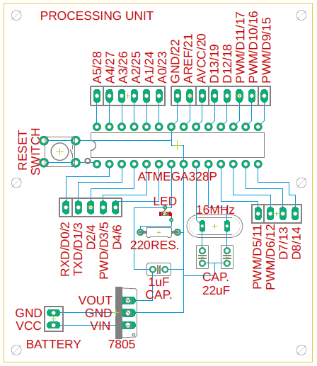
Final PCB design
T
H
E
P
R
O
C
E
S
S
I
N
G
U
N
I
T

Slide 29
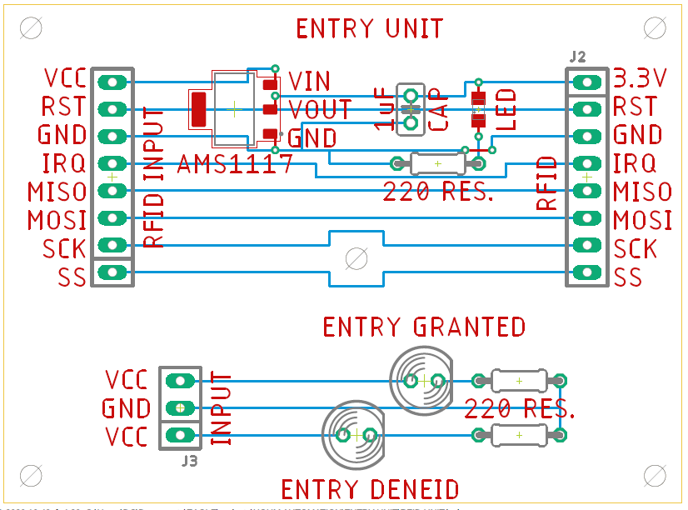
T
H
E
E
N
T
R
Y
U
N
I
T

Slide 30
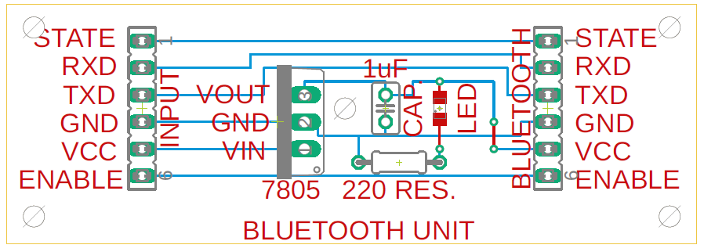
T
H
E
B
L
U
E
T
O
O
T
H
I
N
P
U
T
U
N
I
T

Slide 31
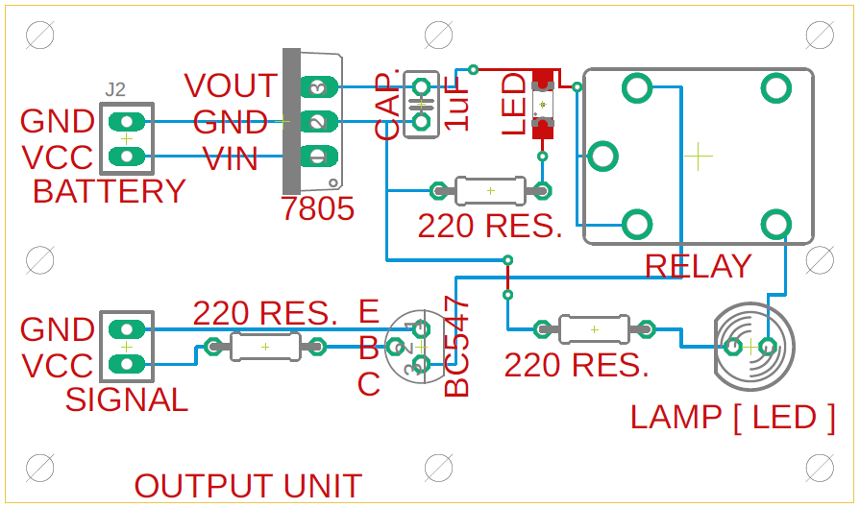
THE OUTPUT UNIT

Slide 32
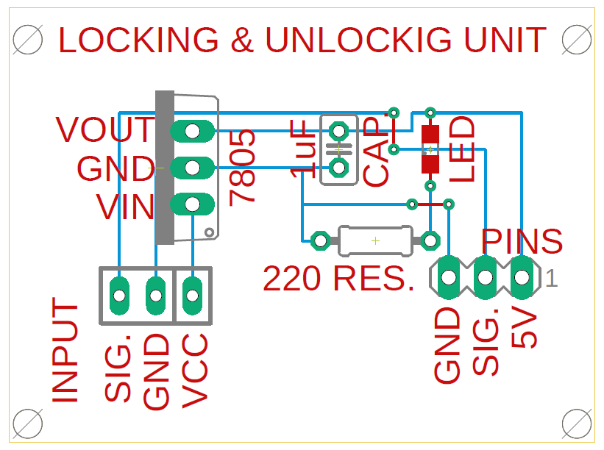
THE LOCKING & UNLOCKING UNIT

Slide 33
Applications
Using this project, we can turn on or off appliances remotely i.e. using a phone or tablet.
The project can be further expanded to a smart home automation system by including some sensors like light sensors, temperature sensors, safety sensors etc. and automatically adjust different parameters like room lighting, air conditioning (room temperature), door locks etc. and transmit the information to our phone.
Using tags we can make attendance system or who one entering in the room at particular time i.e., if any person entered in the room we can find his/her name by tag passcode link with him that’s why we have to link the tags code with the person name or else person ID. This can be done by file handling.
We can used this whole system educational buildings, at governments buildings, especially at military camps and in laboratory and in the hospitals.
Additionally, we can connect to internet and control the home from remote location over internet and also monitor the safety.

Slide 34
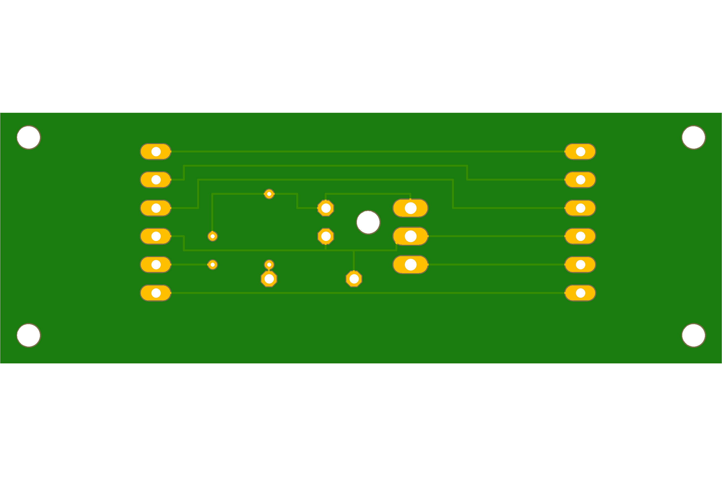
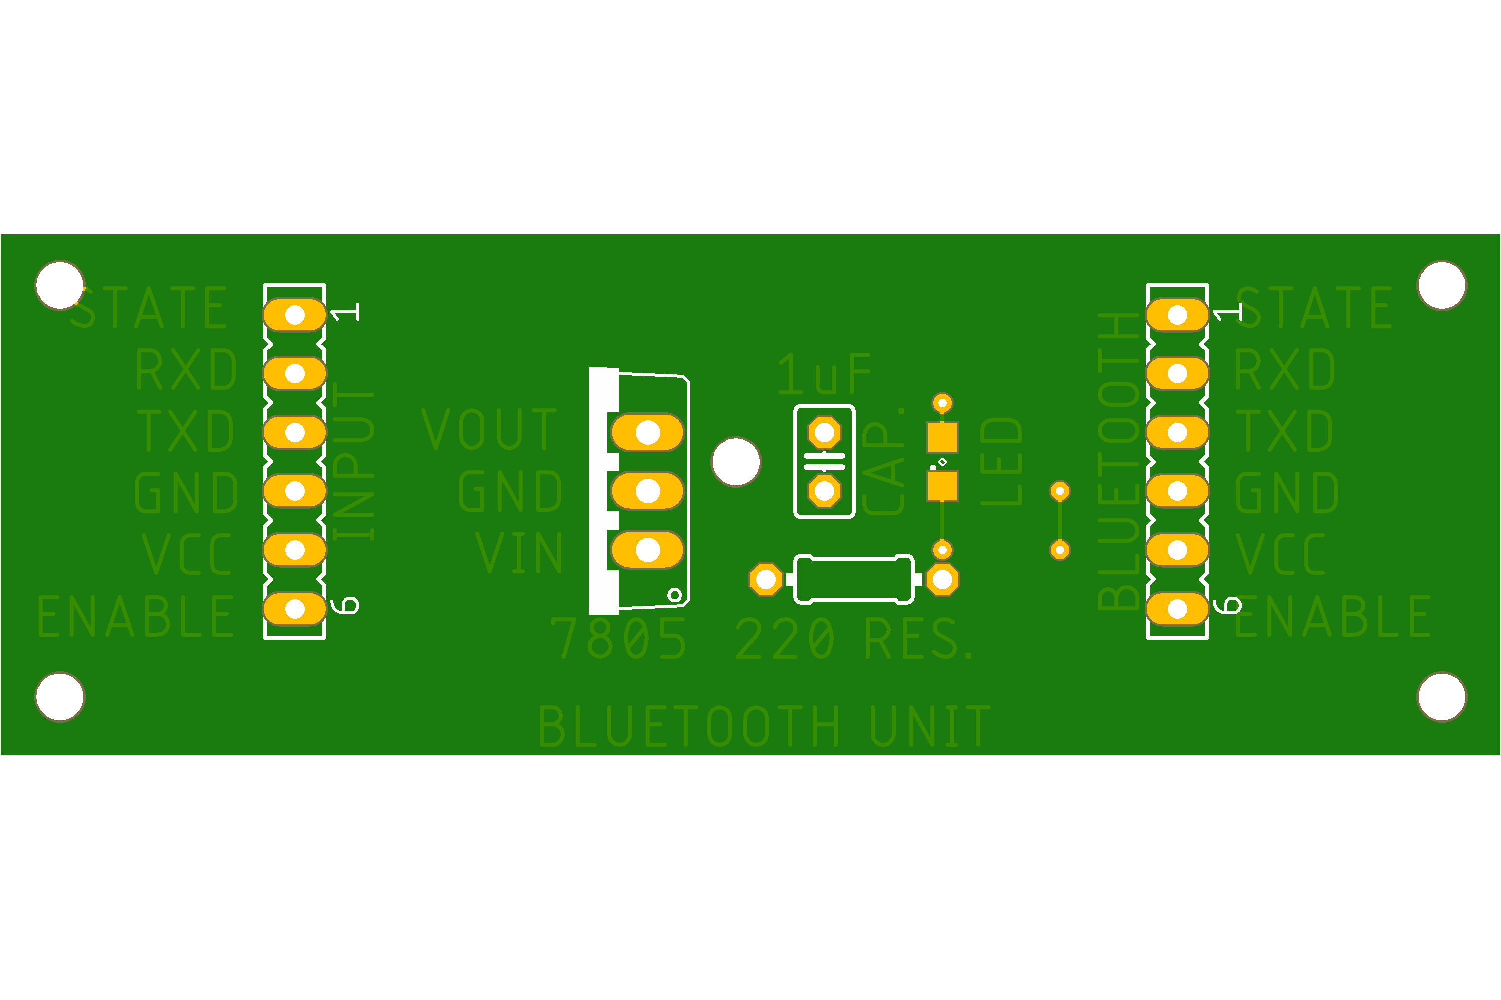
PCB view
THE
BLUETOOTH
INPUT UNIT
BOTTOM VEIW
TOP
VIEW

Slide 35
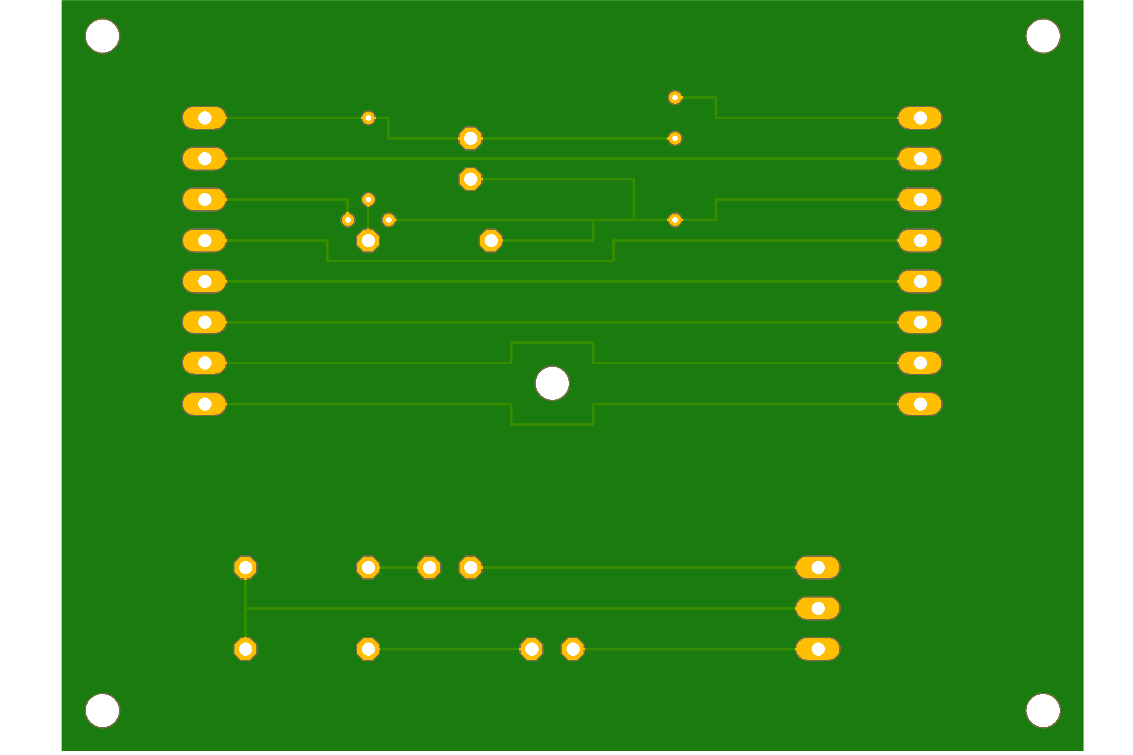
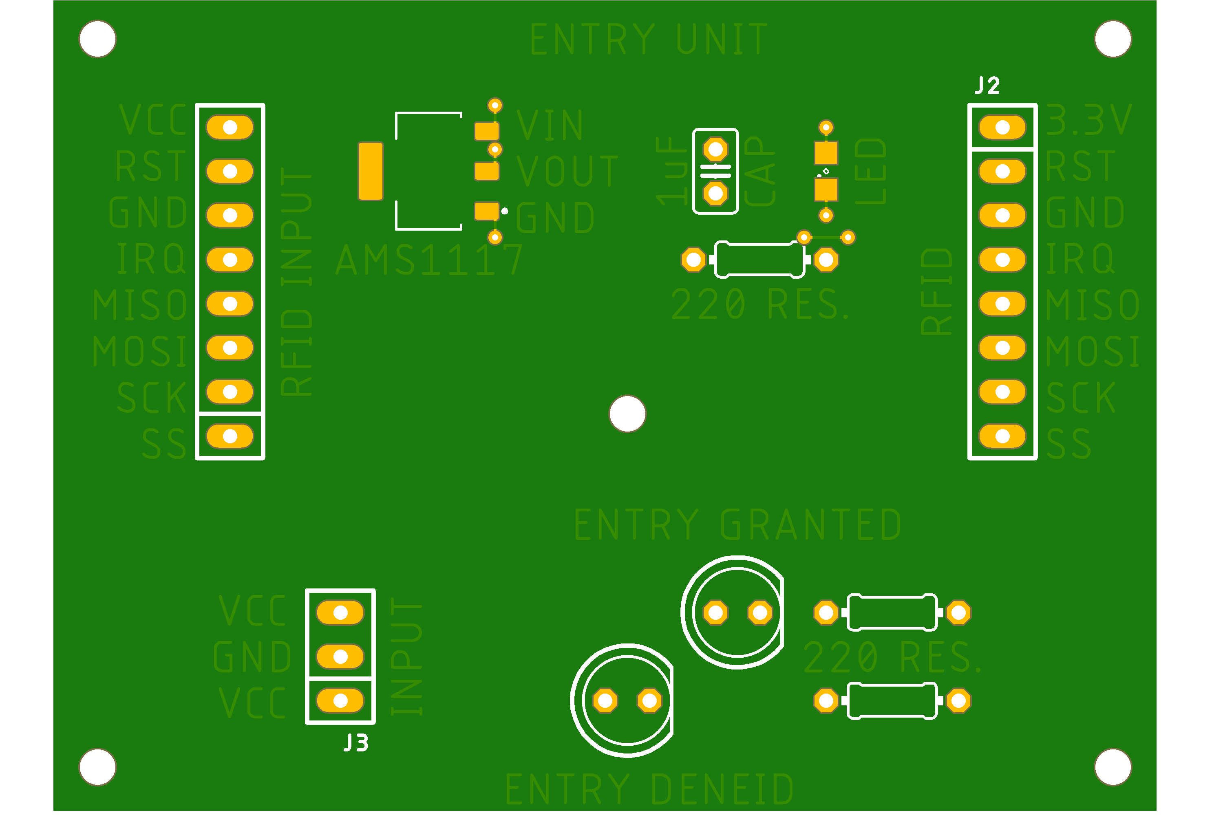
T
H
E
E
N
T
R
Y
U
N
I
T

Slide 36
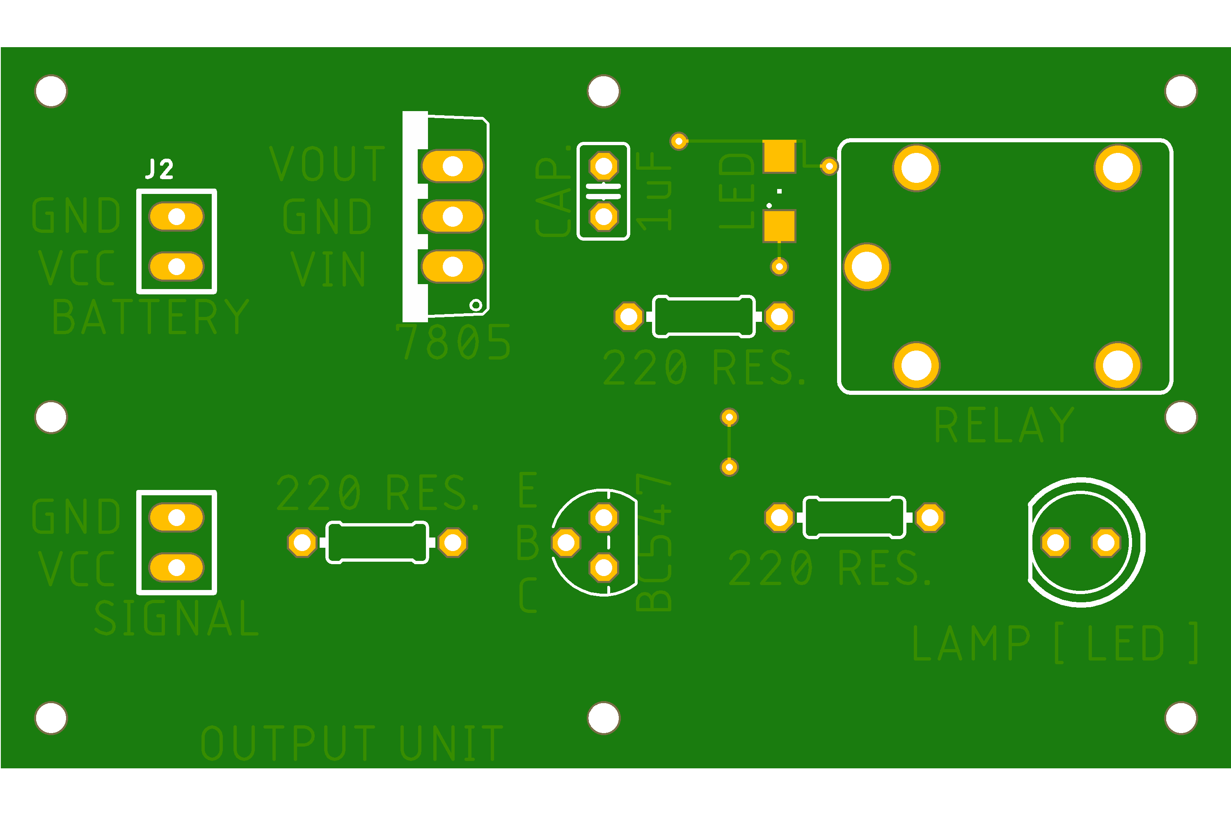
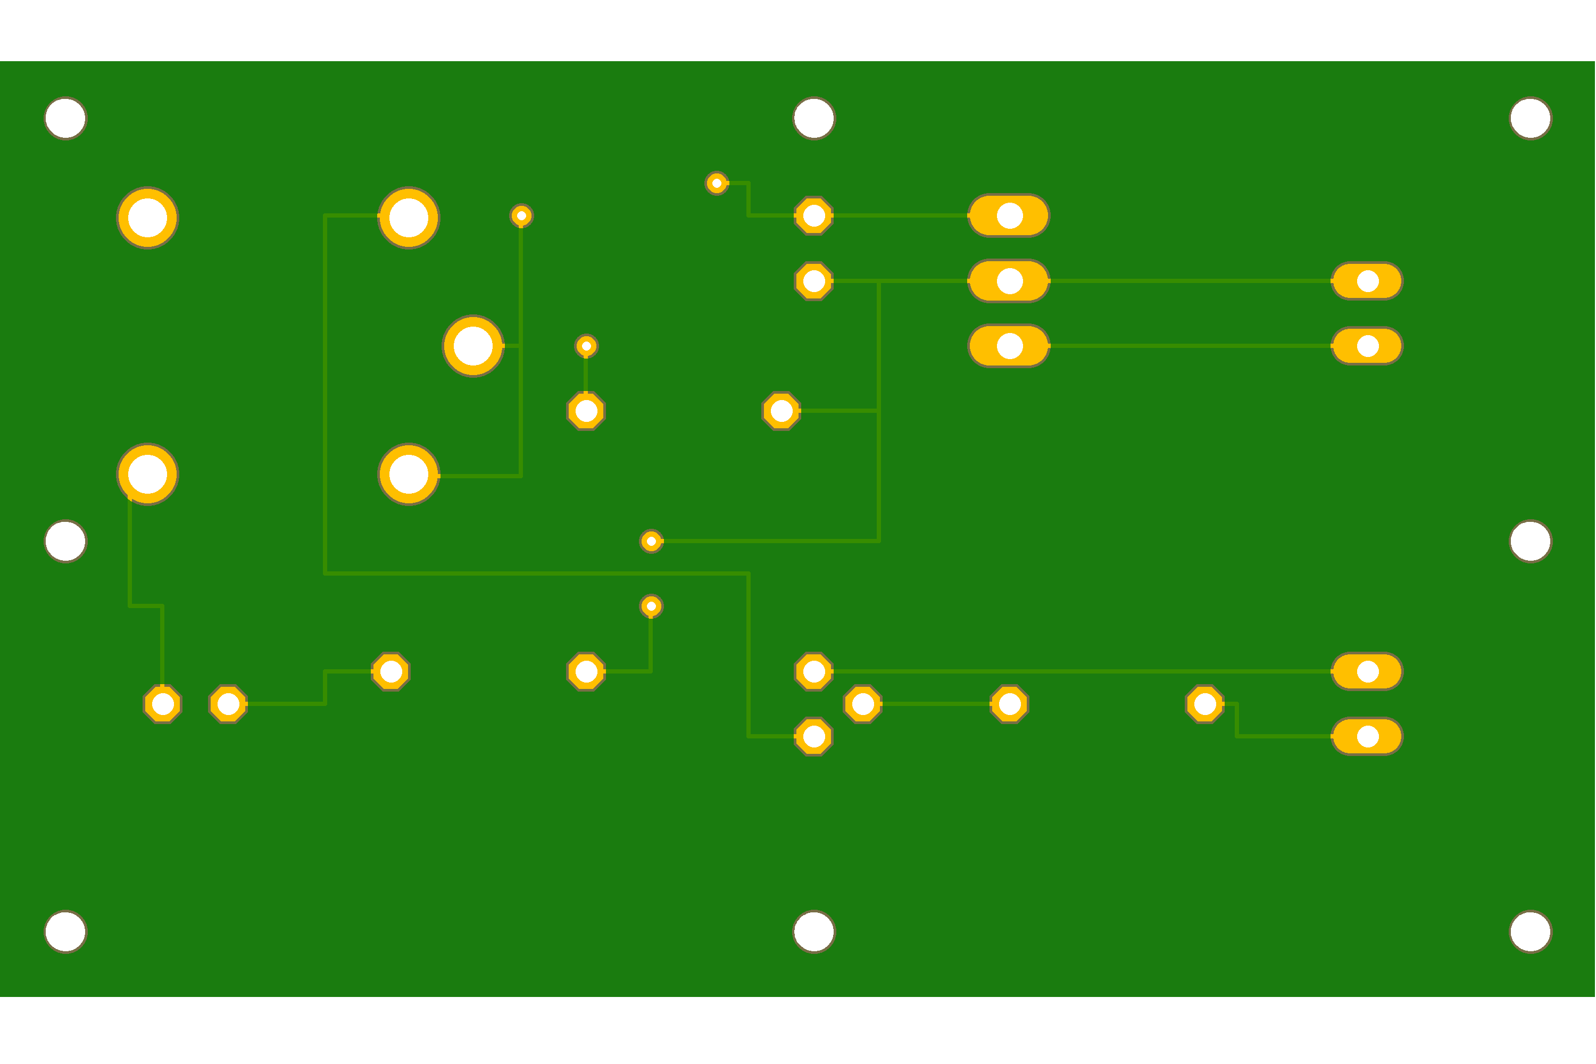
T
H
E
O
U
T
P
U
T
U
N
I
T

Slide 37
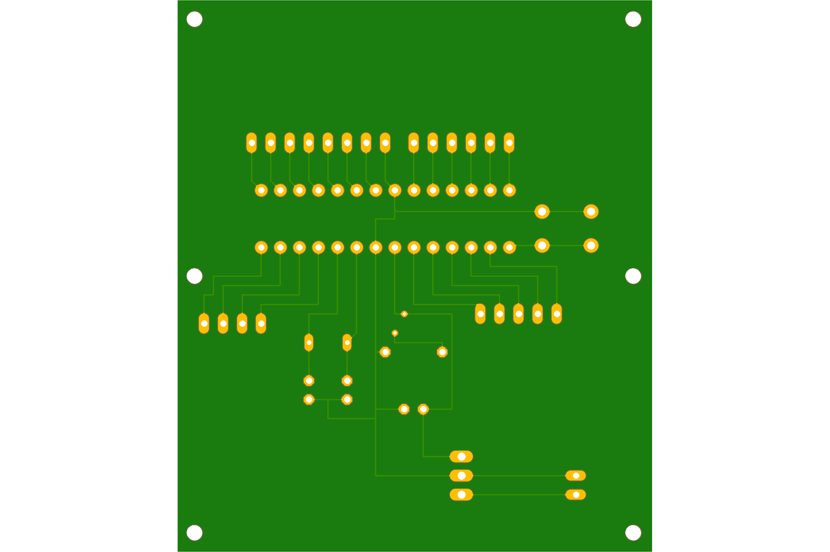
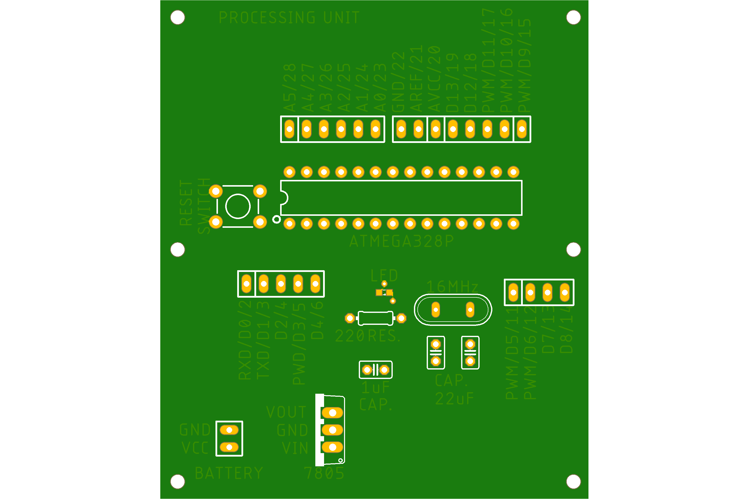
T
H
E
P
R
O
C
E
S
S
I
N
G
U
N
I
T

Slide 38
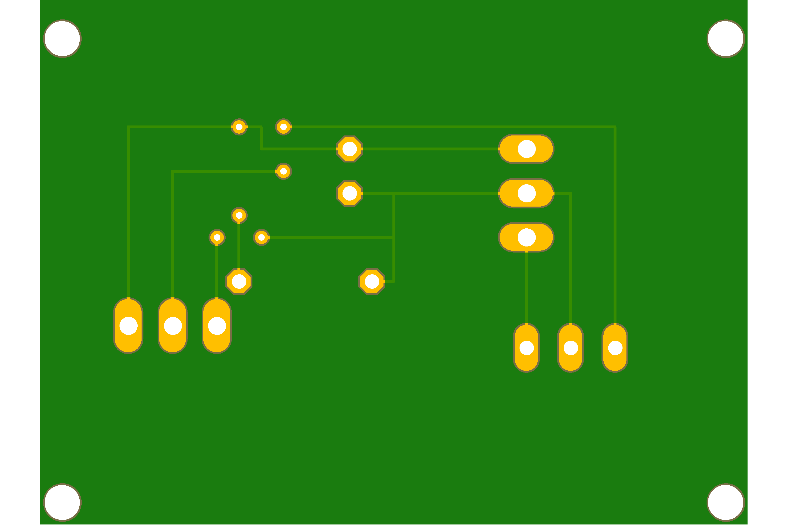
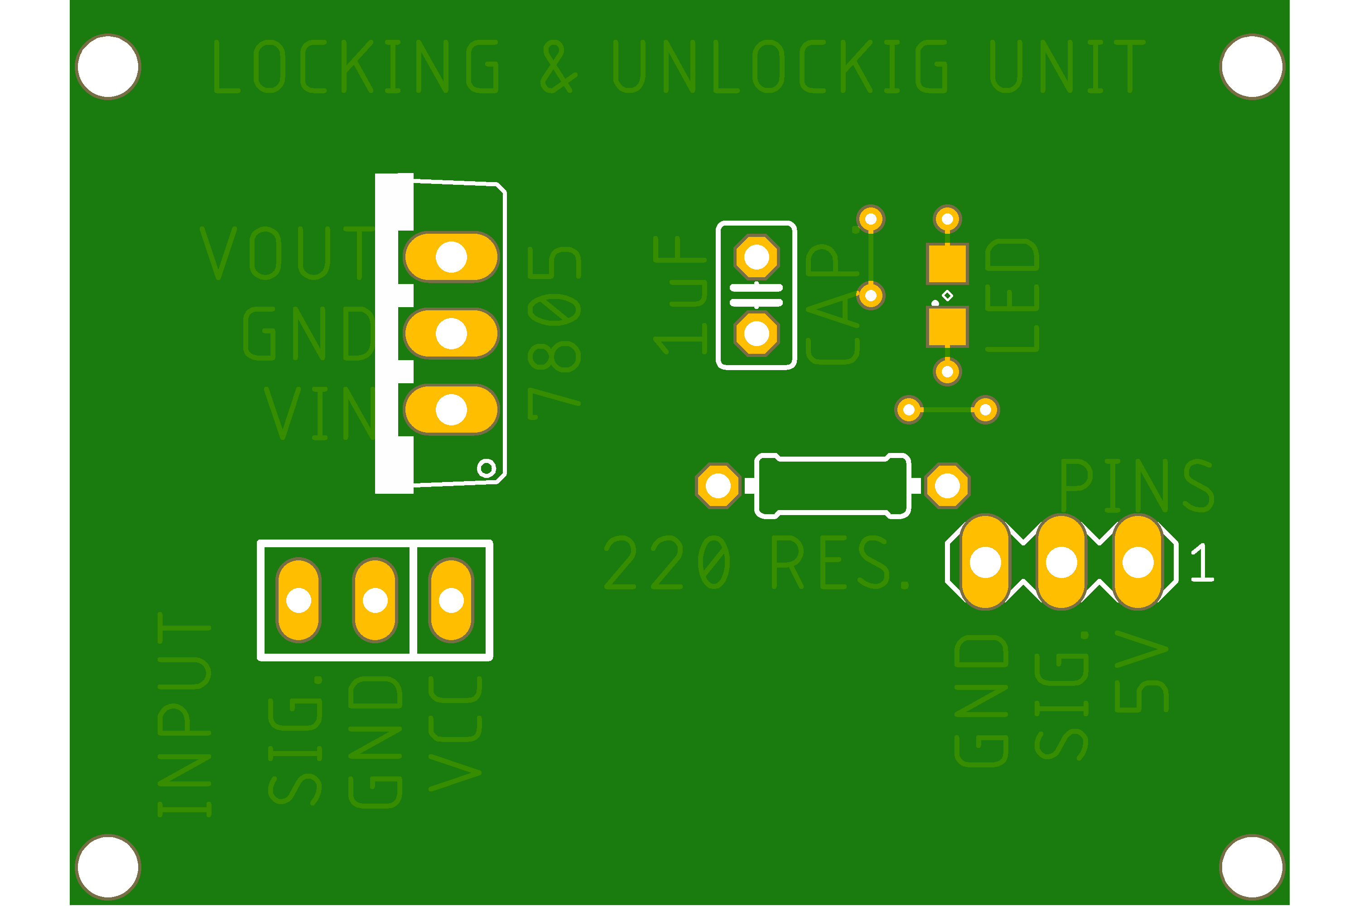
THE LOCKING & UNLOCKING UNIT

Slide 39
Limitations
Human Errors
Disrupted wiring
Not every gadget is compatible with other gadgets
Technological limits
Technology is pricey
Home automation and cyber crime
Using devices and gadgets at home, those are connected to internet serve as loopholes. The internet capable home appliances have served as opportunities for hackers who have managed to steal personal information of the inhabitants through them.
Misuse is possible
losing the tags

Slide 40
The system needs a continuous power supply to be practical or else we might not be able to control the appliances.
Hence, best way to design the system efficiently would be to implement both the automated control and manual control through switches at a time.

Slide 41
Conclusion
The home automation system has been experimentally proven to work satisfactorily by connecting sample appliances to it and the appliances were successfully controlled from a wireless mobile device.
I have learned many skills such as soldering, wiring the circuit and other tools that we use for this project and was able to work individually during this project.
The Bluetooth client was successfully tested on a multitude of different mobile phones from different manufacturers, thus proving its portability and wide compatibility. Thus a low-cost home automation system was successfully designed, implemented and tested.

Slide 42
References
https://en.wikipedia.org/wiki/ATmega328#:~:text=The%20ATmega328%20is%20a%20single-%20chip%20microcontroller%20created,a%20modified%20Harvard%20architecture%208-bit%20RISC%20processor%20core.
https://en.wikipedia.org/wiki/Servo_control
https://en.wikipedia.org/wiki/Radio-frequency_identification
Datasheet of HC-05 https://components101.com/sites/default/files/component_datasheet/HC-05%20Datasheet.pdf
https://components101.com/wireless/rc522-rfid-module
Datasheet of Atmega328P https://www.alldatasheet.com/datasheet-pdf/pdf/313218/ATMEL/ATmega328P.html
https://www.alldatasheet.com/

Slide 43


